Slide 1
Time Series Forecasting Part 2
Nakul Bajaj

Slide 2
Lets revise from Last week
Forecast
Correlation vs Causation
Seasonality vs Cyclicity
Trend – Up Down or No trend (stationary)
How we can statistically identify the trend
Lags
Autocorrelation
Bits on ARIMA

Slide 3
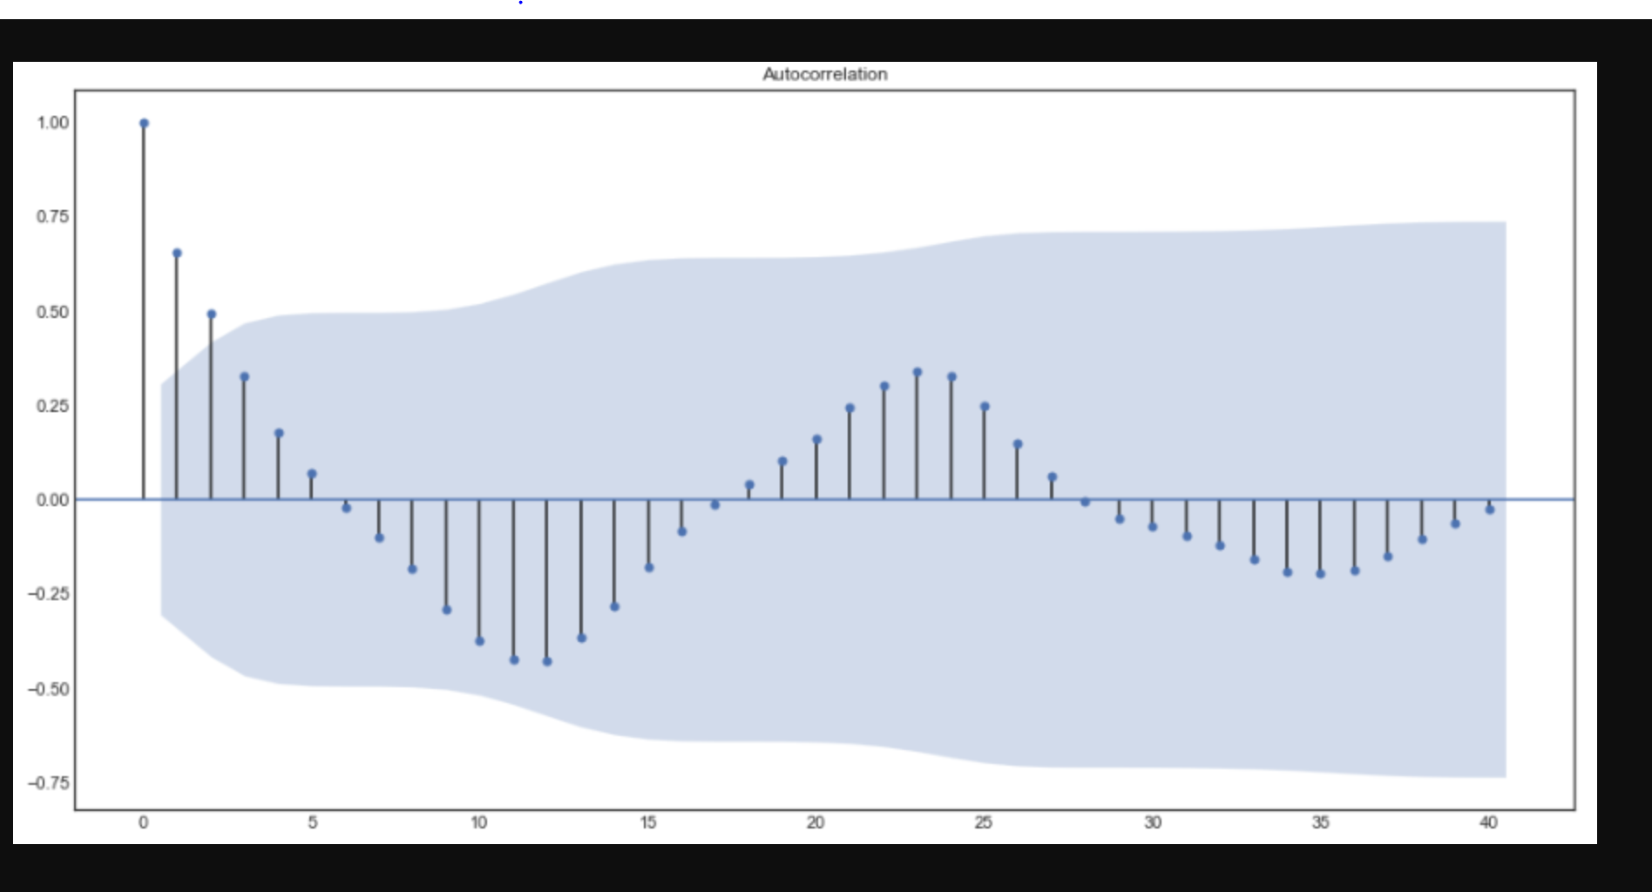
How to determine the AR part of ARIMA?
How many lags?

Slide 4
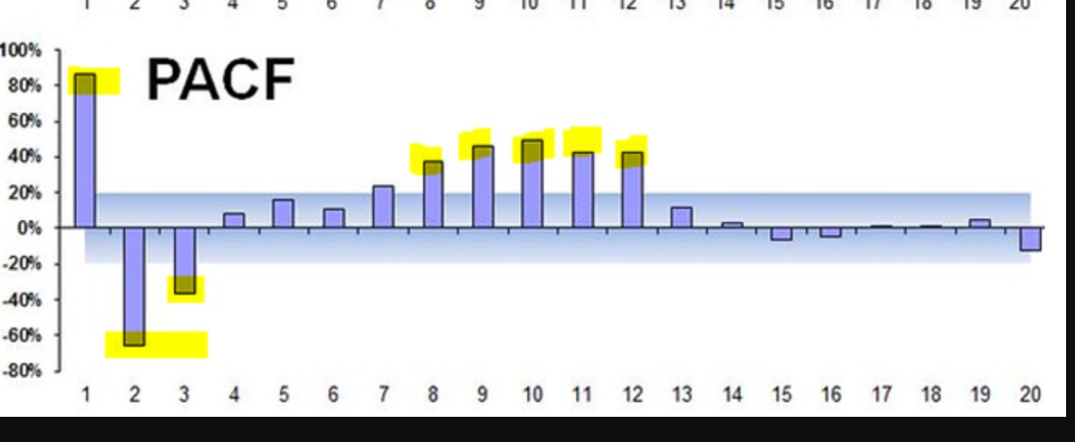
How to determine MA part of ARIMA?
How many lags?

Slide 5
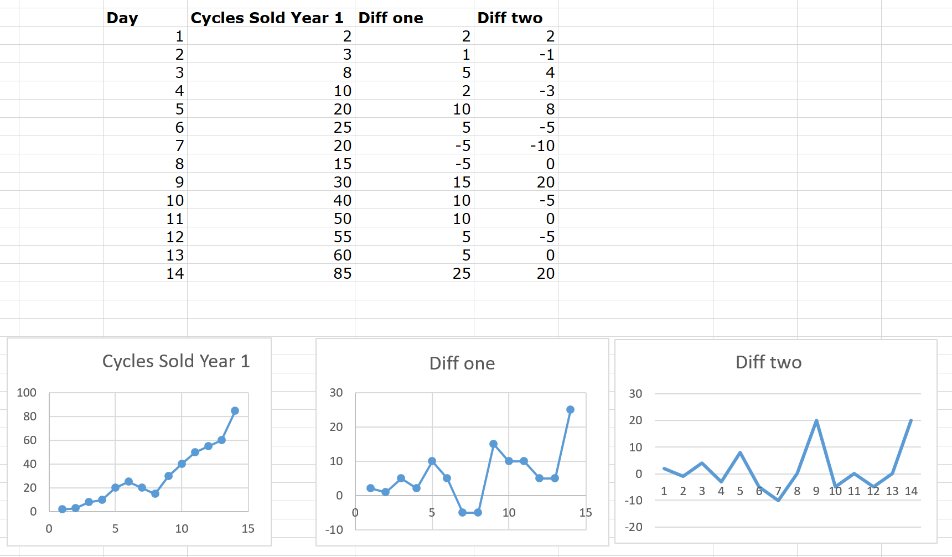
How to determine I for ARIMA
Is data stationary?

Slide 6
Steps to validate the model?
Split the model into train test set
Train the model on training set
Get the predictions using test set
Compare the values between test and predictions
Use a good measure: RMSE, MAE, MSE, MAPE, etc

Slide 7
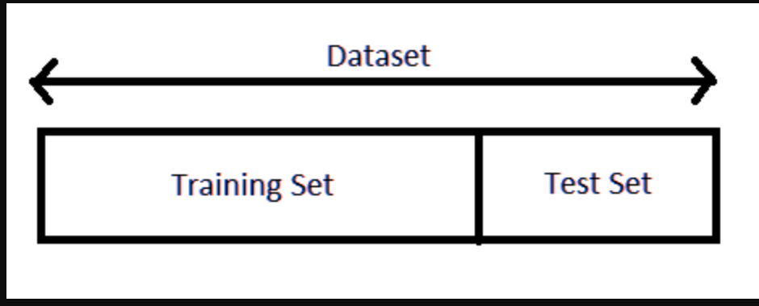
Why do we split the data in train and test?
Because we must and is an industry practice
Because my manager asked me to do so
Because we must train before we could test our potential
Because its good to know whether our model will perform in the real world, as we will not know that until the future comes ✅

Slide 8
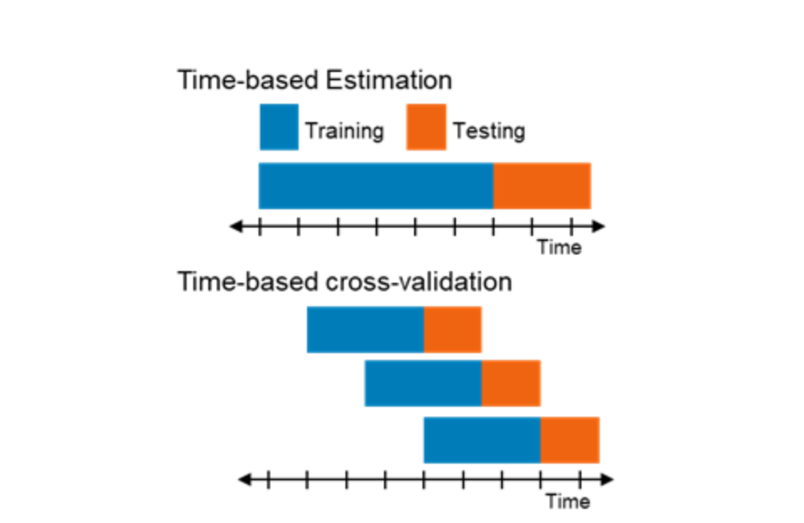
How should we split the time series data?
Random
Sequentially

Slide 9
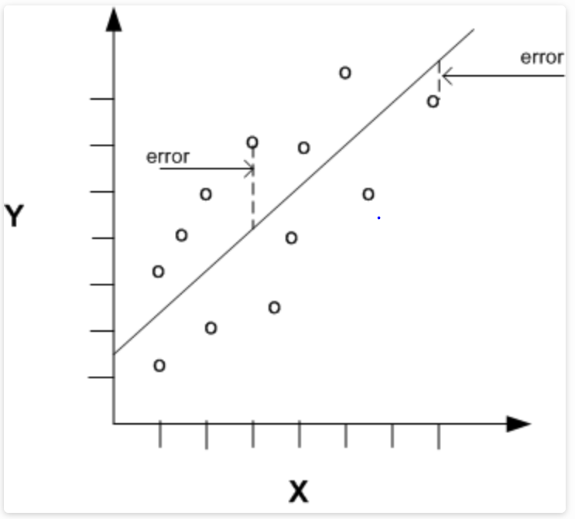
Whats a good evaluation metric?
Mean error
What will happen to positives and negatives
Mean Absolute Error
What happens if lot of errors are in negative
Mean Square Error ✅
Root Mean Square Error ✅
Mean Absolute Percentage Error ✅

Slide 10
Lets move on to Jupyter notebook
Get the data from BQ ✅
Explore the data ✅
Run some statistical tests ✅
We will do Auto Arima in Python ✅
We will use BQML (auto Arima) ✅
Split it into Train test ✅
Train and Test the model ✅
We will visualize the results ✅
We will add holiday or other variables to the data ✅
And revisualize ✅
Exploring facebook prophet library ✅
Trying neural prophet, Neural networks developed by FB ✅

Slide 11
Some Resources
Jupyter Notebook
https://github.com/Nakulbajaj101/forecasting-part-two
Forecasting course on Udemy
https://www.udemy.com/course/python-for-time-series-data-analysis
BQML documentation
https://cloud.google.com/bigquery-ml/docs https://cloud.google.com/bigquery-ml/docs/bigqueryml-web-ui-start
https://cloud.google.com/bigquery-ml/docs/arima-single-time-series-forecasting-tutorial

Slide 12
Summarise
We learnt about what is forecasting
We learnt about why forecasting is important
We learnt key concepts in time series
We learnt how to approach time series forecasting
We learnt about ARIMA modelling in Python
We learnt about using Facebook prophet
We learnt about using BQML

Slide 13
Thank you

